Slide 1
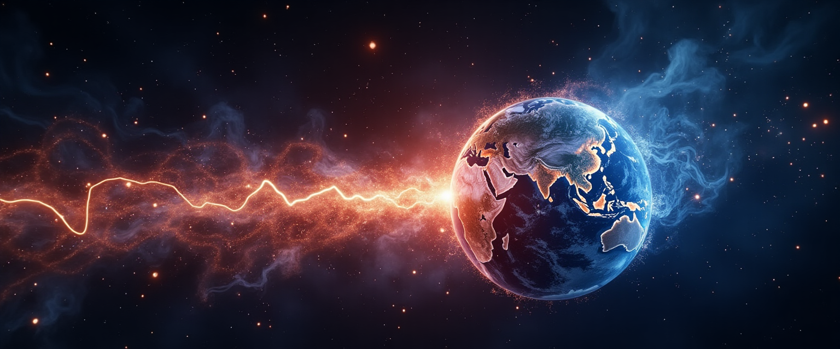

Your Health Monitor from Space:
Early Stroke Detection with Space Data
Image generated with AI.

Slide 2



Fehmi Gültekin
Pharmacist
MBA
Project Management
8+ years of Pharma/
Healthcare experience
Soumya Mondal
M.Sc. Computer Science
ML Research Engineer
Product Management
5 years of experience in AI research & startups
Julia Nuss
Pharmacy Technician
XR Development
Data Science & ML
5 years of experience in pharmacy
NeuroStorm – Your Health Monitor from Space: Early Stroke Detection with Space Data GER 18/05/2025

Slide 3
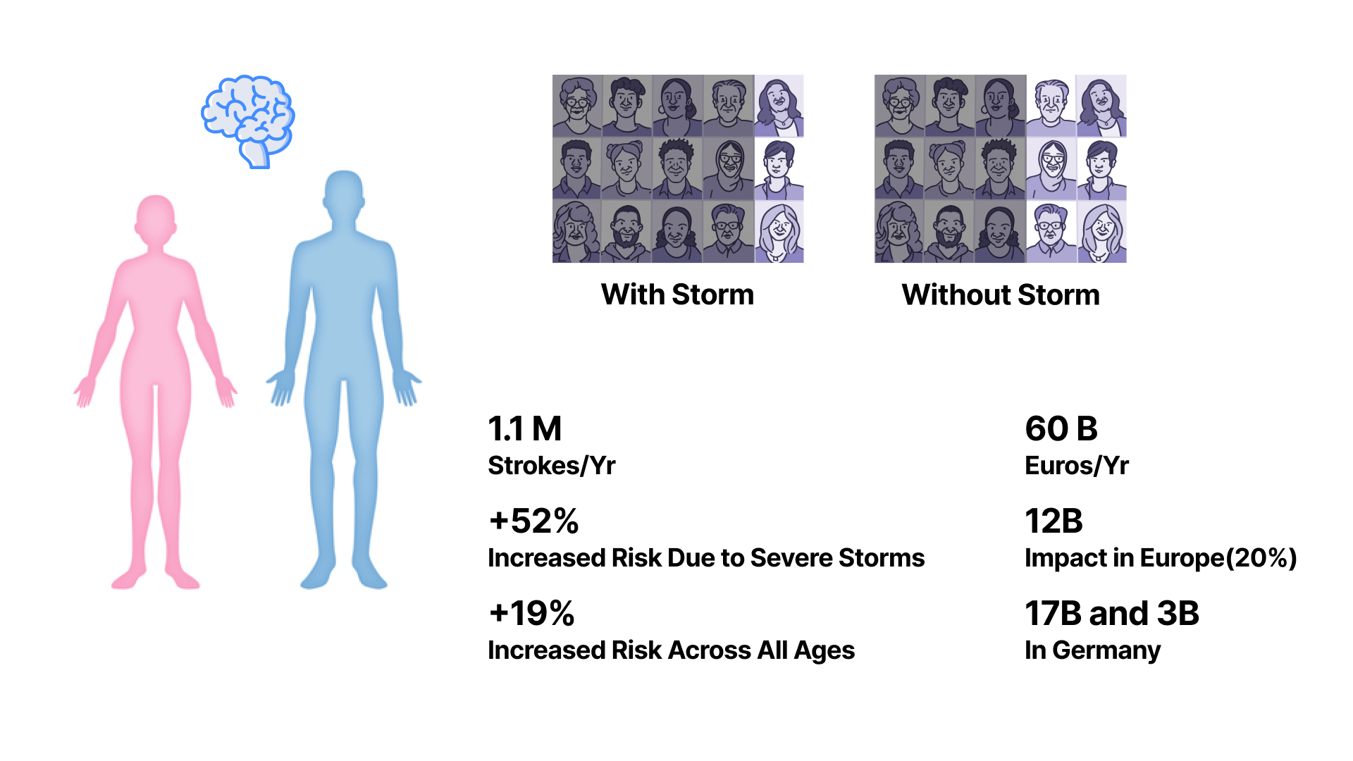
Feigin, V. L. et al. (2014). Geomagnetic Storms Can Trigger Stroke: Evidence From 6 Large Population-Based Studies in Europe and Australasia. Stroke, 45(6), 1639–1645.
Stroke Alliance for Europe (SAFE). (2019). The Economic Impact of Stroke in Europe (Executive Summary). Retrieved from https://touchneurology.com/wp-content/uploads/sites/3/2020/01/executive-summary-final-e-version_compressed_22.11.2019.pdf
NeuroStorm –Your Health Monitor from Space: Early Stroke Detection with Space Data GER 18/05/2025

Slide 4
NeuroStorm – Your Health Monitor from Space: Early Stroke Detection with Space Data GER 18/05/2025

